Slide 1
Architectural Style
Lakshmi Sudheera Dama
Ridhima Joshi
(Group 4)

Slide 2
Software Architecture
Defined in terms of :
Components
Connectors
Configuration
Depicts the system’s organization or structure
Provides an explanation of how it behaves

Slide 3
Architectural Style
Defines :
Set of Element Types
Set of Constraints
It is a shape of an application.

Slide 4
Definition
According to David Garlan & Mary Shaw:
A family of systems in terms of a pattern of structural organization. More specifically, an architectural style determines the vocabulary of components and connectors that can be used in instances of that style, together with a set of constraints on how they can be combined. These can include topological constraints on architectural descriptions (e.g., no cycles). Other constraints - say, having to do with execution semantics - might also be part of the style definition.
[January 1994, CMU-CS-94-166]

Slide 5
Architectural Style Properties
Vocabulary of Design Elements
Configuration Rules
Interpretation
Analyses

Slide 6
Characterising an architectural style
We can understand what a style is by answering the following questions.
What is the structural pattern (i.e., components, connectors, constraints)?
What is the underlying computational model ?
What are the essential invariants of the style?
What are some common examples of its use?
What are the advantages and disadvantages of using that style?
What are some of the common specializations of that style?

Slide 7
Architectural patterns vs. Architectural styles
Architectural patterns define the implementation strategies of those components and connectors (‘how?’)
• More domain specific
Architectural styles define the components and connectors (‘what?’)
• Less domain specific

Slide 8
Benefits of Using Styles
Reuse
• Design: Well-understood solutions applied to new problems
• Code: Shared implementations of invariant aspects of a style
Understandability of system organization
• A phrase such as “client-server” conveys a lot of information
Interoperability
• Supported by style standardization
• components can be independently developed with a particular style in mind
Style-specificity
• Analyses: enabled by the constrained design space
• Visualizations: depictions matching engineers’ mental models

Slide 9
List of architectural styles
Data flow
Pipe-and-filter
Batch sequential processing
Independent components
Event-based implicit invocation
Call and return
Layered system
Data abstraction
Data-centred
Virtual machine

Slide 10
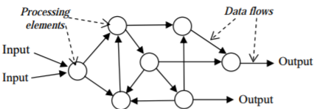
Data Flow Style
Data flow is a software architectural style that is widely used in various application domains where data processing plays a significant role.
Illustration of data flow style

Slide 11
Batch Sequential
(Data Flow)
Advantages
Each subsystem can be an independent program working on input data and producing output data.
Disadvantages
Does not provide concurrency and interactive interface

Slide 12
Pipe-and-Filter
(Data Flow)
Advantages
Concurrency and high throughput for excessive data processing.
Reusability and simplifies system maintenance
Simplicity by offering clear divisions between any two filters connected by pipe.
Flexibility by supporting both sequential and parallel execution.
Disadvantages
Not suitable for dynamic interactions.
Loss of performance and increase complexity on data transmission.

Slide 13
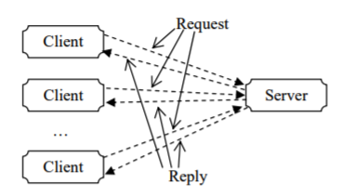
Independent Component Style
The architectural style of independent components has attracted increasing interest recently for its strong support to software reuse and evolution due to its ease of integration of components into a system.
Example of Independent Component Style

Slide 14
Event based implicit invocation
(Independent components)
Advantages
It supports reuse.
System evolution is easy in this architecture.
It is suitable for asynchronous communication.
Disadvantages
Components do not have control over computation since they can generate events only
Responses to the events are not ordered.
Analysis via pre and post condition is difficult.
Exchange of data requires global data or shared repository, so resource management become challenging.

Slide 15
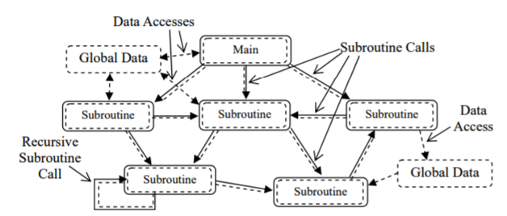
Call and Return Style
Call-and-return architecture has been the dominant architectural style in large systems for the past 30 years. This is directly supported by the classical and current programming paradigms.
Structure of call and return architectures

Slide 16
Layered Architecture
(Call and Return)
Advantages
High abstraction level.
Easy to enhance
Reusable
Disadvantages
Level of abstraction is difficult to decide.
Low performance
Dividing every system into layers and deciding the functionality of layers is difficult.

Slide 17
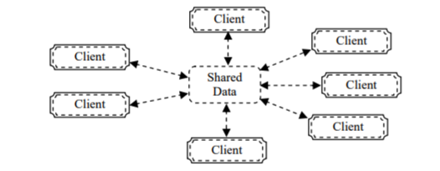
Data Centered Style
The term data-centred architecture refers to systems in which the access and update of a widely accessed data-store is an apt description.
Data Centered Style

Slide 18
Data- centered architecture
Advantages
Suitable for complex problem
Very helpful for network based applications.
Useful in the systems that involve shared access to data with loosely coupled agents
Disadvantages
Not suitable for every problem.
Designing of good controller is very important.
If number of knowledge sources requested to access the shared data increases then bottleneck problem arises at the controller

Slide 19
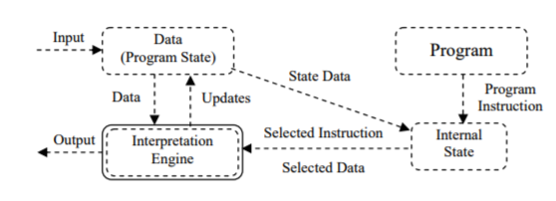
Virtual Machine Style
Virtual Machine Architecture

Slide 20
Virtual machine
Advantages
It produces the machine independent code.
Disadvantages
Slow performance

Slide 21
References
Zhu, Hong. Software Design Methodology : From Principles to Architectural Styles, Elsevier Science & Technology, 2005. ProQuest Ebook Central, https://ebookcentral.proquest.com/lib/uhcl/detail.action?docID=269543.
R. T. Monroe, A. Kompanek, R. Melton and D. Garlan, "Architectural styles, design patterns, and objects," in IEEE Software, vol. 14, no. 1, pp. 43-52, Jan/Feb 1997.doi: 10.1109/52.566427
https://cs.uwaterloo.ca/~gweddell/cs446/NewArch.pdf

Slide 22
Thank you

